Slide 1
Refinement of state-charts with run-to-completion semantics
Karla Morris
Rob Armstrong
Sandia National
Laboratories
Colin Snook
Thai Son Hoang
Michael Butler
University of
Southampton

Slide 2
Terminology
Trigger
event in SCXML, UML etc.
Aka internal signal, external stimulus
Event-B event
a state transition in the underlying formalism
Transition
SCXML transition
UML-B transition (fired by executing an Event-B event)

Slide 3
Motivation
INDUSTRY LED
Sandia engineers use run-to-completion statecharts
but also want to use refinement and to prove safety properties
Aware of Event-B and its automatic theorem provers
We do NOT want another semantics for statecharts
But we need some extra features for refinement
Abstractions - Non-determinism
Refinement levels – adding details
Invariant – properties to prove

Slide 4
Background
Event-B is designed for automatic proof
Simple guarded actions
to achieve automatic proof
UML-B diagrammatic front-end for Event-B
NOT UML – no run to completion semantics
ONLY untriggered transitions

Slide 5
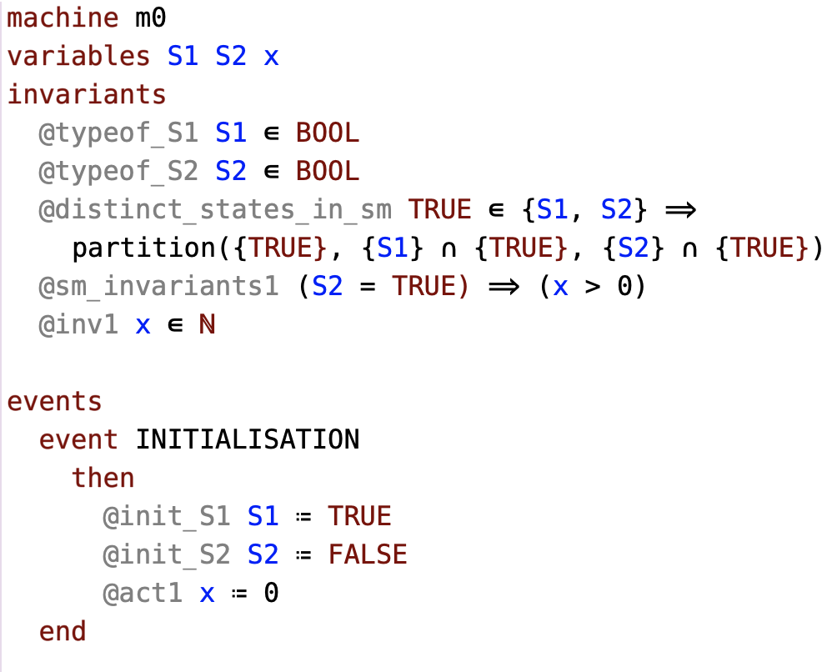
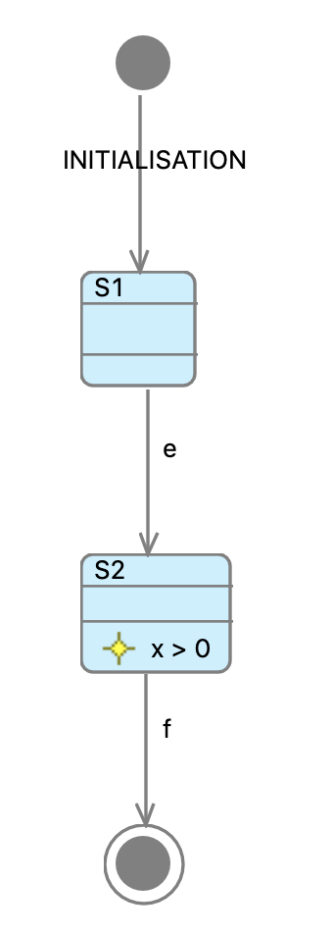
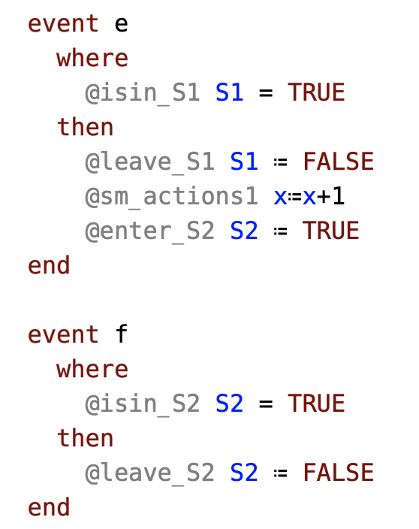
UML-B → Event-B
n.b. There is an alternative translation to an enumeration
Typically, add nested state-machines in refinements.
Invariants in states

Slide 6
Run to completion Semantics
External Q of stimulus triggers
Internal Q of raised triggers
Transitions can be enabled by triggers
Or left as un-triggered guarded transitions
Transitions can raise internal triggers
Transitions can also have other guards and actions

Slide 7
Run to completion Semantics
RUN:
Dequeue an external trigger
fire transitions enabled by this trigger
this may enable untriggered transitions –
Keep firing them until none enabled
While internal Q is not empty:
dequeue an internal trigger
fire transitions enabled by this trigger
this may enable untriggered transitions –
Keep firing them until none enabled
COMPLETION:
When no transitions enabled and the internal Q is empty

Slide 8
What do we want : In refinement of State-charts…
Strengthen guards of transitions
predicates about other data and parallel statecharts
more specific (nested) source states
Add actions to transitions
Raise internal trigger
Modify ancillary data
Add nested statecharts
Add external/internal triggers

Slide 9
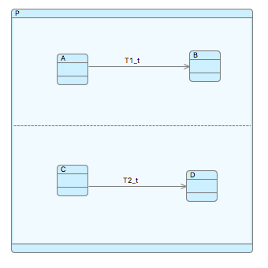
Consideration: Refining R2C
In Scenario A+C
Transitions T1 & T2 must both fire for completion

Slide 10
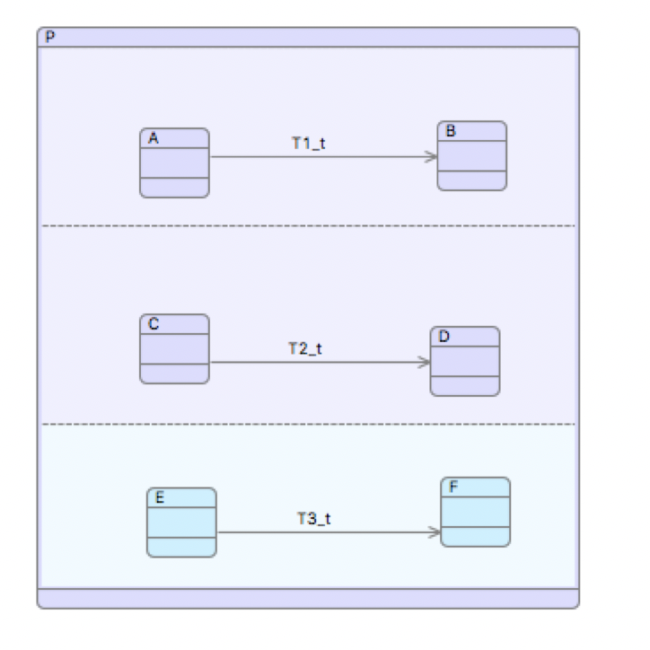
Consideration: Refining R2C
In Scenario A+C
Transitions T1,T2 must fire for completion
Scenario A+C+E
T3 has been added in a refinement.
Transitions T1,T2,T3 must fire for completion
OK - Completion is stronger

Slide 11
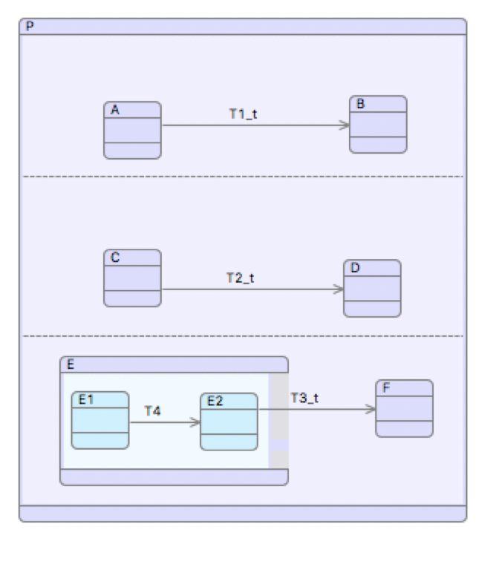
Consideration: Refining R2C
Scenario A+C+E…+E1
Guard of T3 is stronger
it is no longer enabled in this sub-scenario
Only transitions T1,T2 must fire for completion
NOT OK - the guard for completion is weaker
This is not a refinement of the abstract completion event

Slide 12
Solution
The abstraction was wrong
We must allow completion to happen without transitions firing
(Unless we know for sure that they will remain enabled in future refinements)
The refinement proof forces us to make correct abstractions
I.e. skip transitions even if they are enabled.
If we are sure we won’t strengthen a transition guard,
we can flag it as finalised
then it cannot be skipped by completion

Slide 13
Transition Sets
Fire all enabled transitions together in one atomic step
Simplifies infrastructure
Need a separate Event-B event for each combination
Potential explosion.. but in practice unlikely
Alternative encodings are possible
More complicated operational ‘engine’
More difficult proof

Slide 14
Transition Sets (TS)
TS0: [t]/{}
TS1: [A∧t]/ {T1}
TS2: [C∧t]/ {T2}
TS3: [A∧C∧t]/ {T1,T2}
TS4: [E∧t]/ T3
TS5: [A∧E∧t]/ {T1,T3} (refines TS1)
TS6: [C∧E∧t]/ {T2,T3} (refines TS2)
TS7: [A∧C∧E∧t]/ {T1,T2,T3} (refines TS3)
Or if all 3 are ‘finalised’
TS0: [~A∧~C∧~E∧t]/skip
TS1: [A∧~C∧~E∧ t]/ T1
TS2: [~A∧C∧~E∧t]/ T2
TS3: [A∧C∧~E∧t]/ (T1 || T2)
TS4: [~A∧~C∧E∧t]/ T3
TS5: [A∧~C∧E∧t]/ (T1 || T3) (refines TS1)
TS6: [~A∧C∧E∧t]/ (T2 || T3 ) (refines TS2)
TS7: [A∧C∧E∧t]/ (T1 || T2 || T3) (refines TS3)

Slide 15
Translation: Our Approach
Abstract Basis – generic – for any statechart
embodies semantics of R2C
We could swap in new semantics by replacing basis
statechart -> a chain of refinements
Starting from the abstract Basis
statechart translates to iUML-B state-machine
Transitions refine Abstract basis transitions

Slide 16
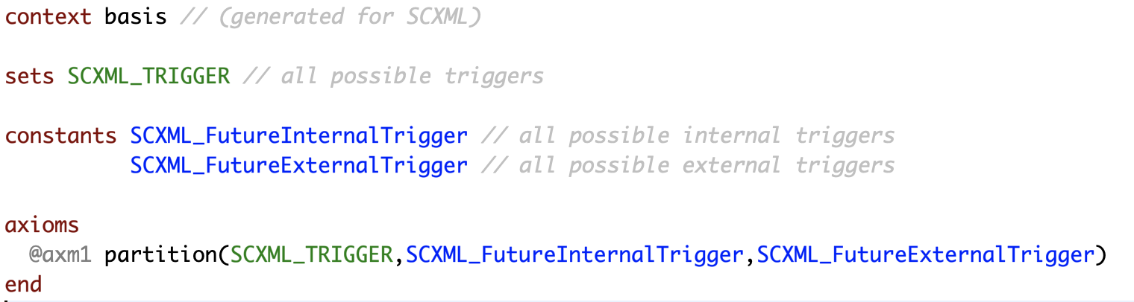
Basis - Context
AUTOMATICALLY
GENERATED

Slide 17
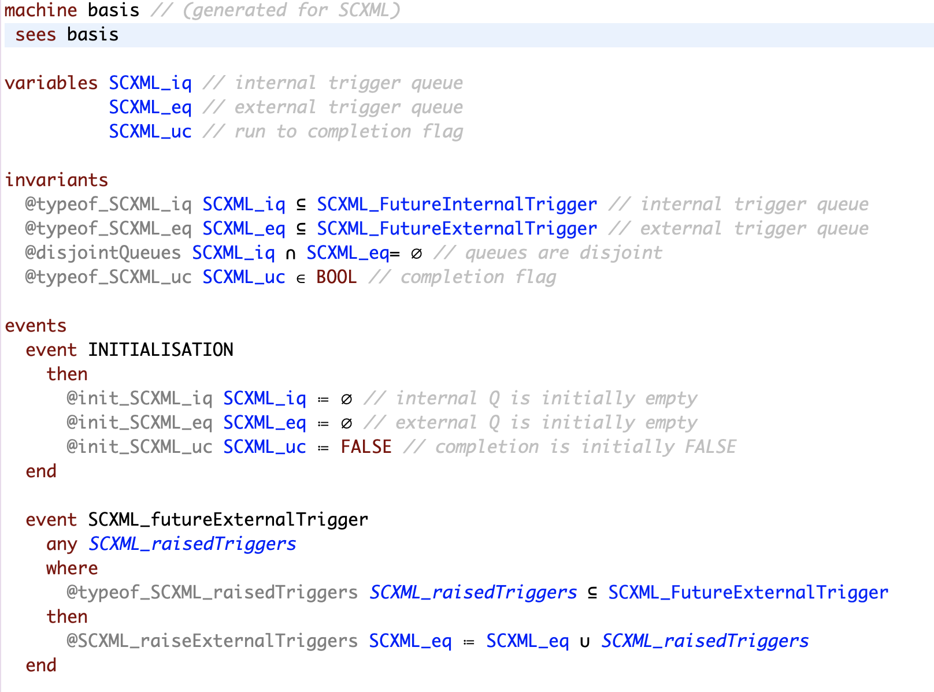
Basis - Machine
AUTOMATICALLY
GENERATED
n.b for now, queues are sets
In refinements translator adds guards to specify value of parameters e.g.
SCXML_raisedTriggers = {myExternalTrigger}

Slide 18
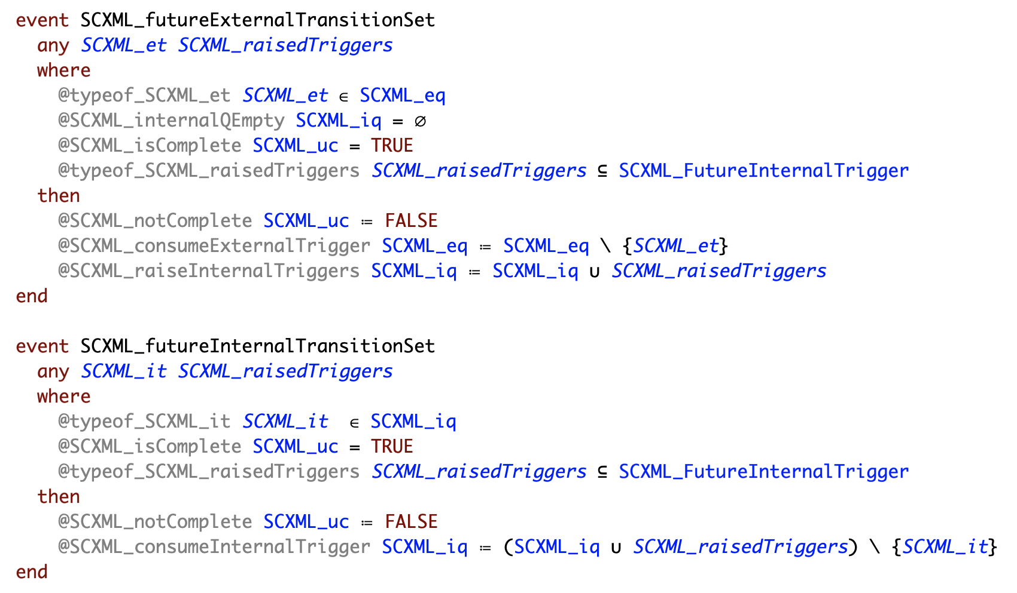
AUTOMATICALLY
GENERATED

Slide 19
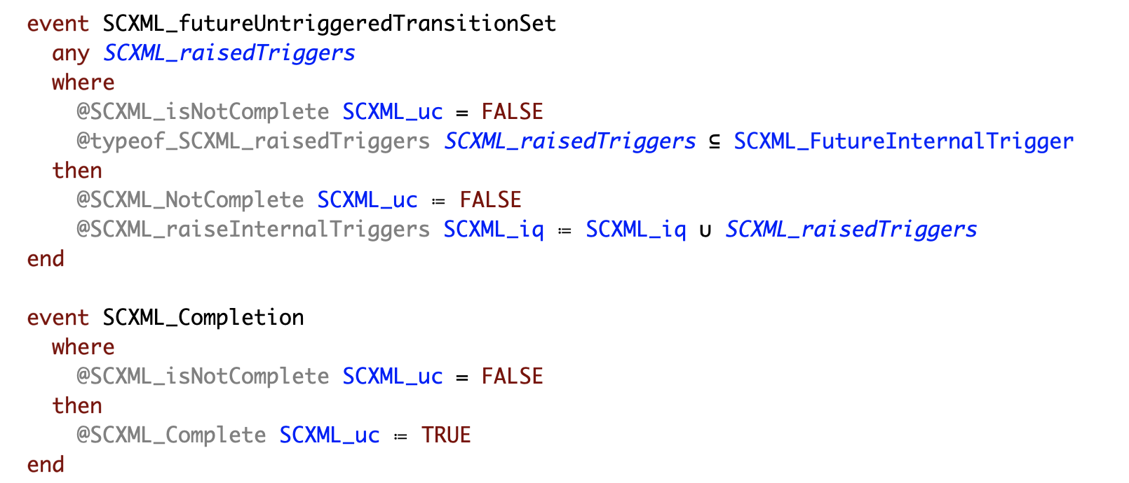
AUTOMATICALLY
GENERATED
Completion can occur anytime after an external trigger.
Refinements will not change this unless transitions are ‘finalised’.

Slide 20
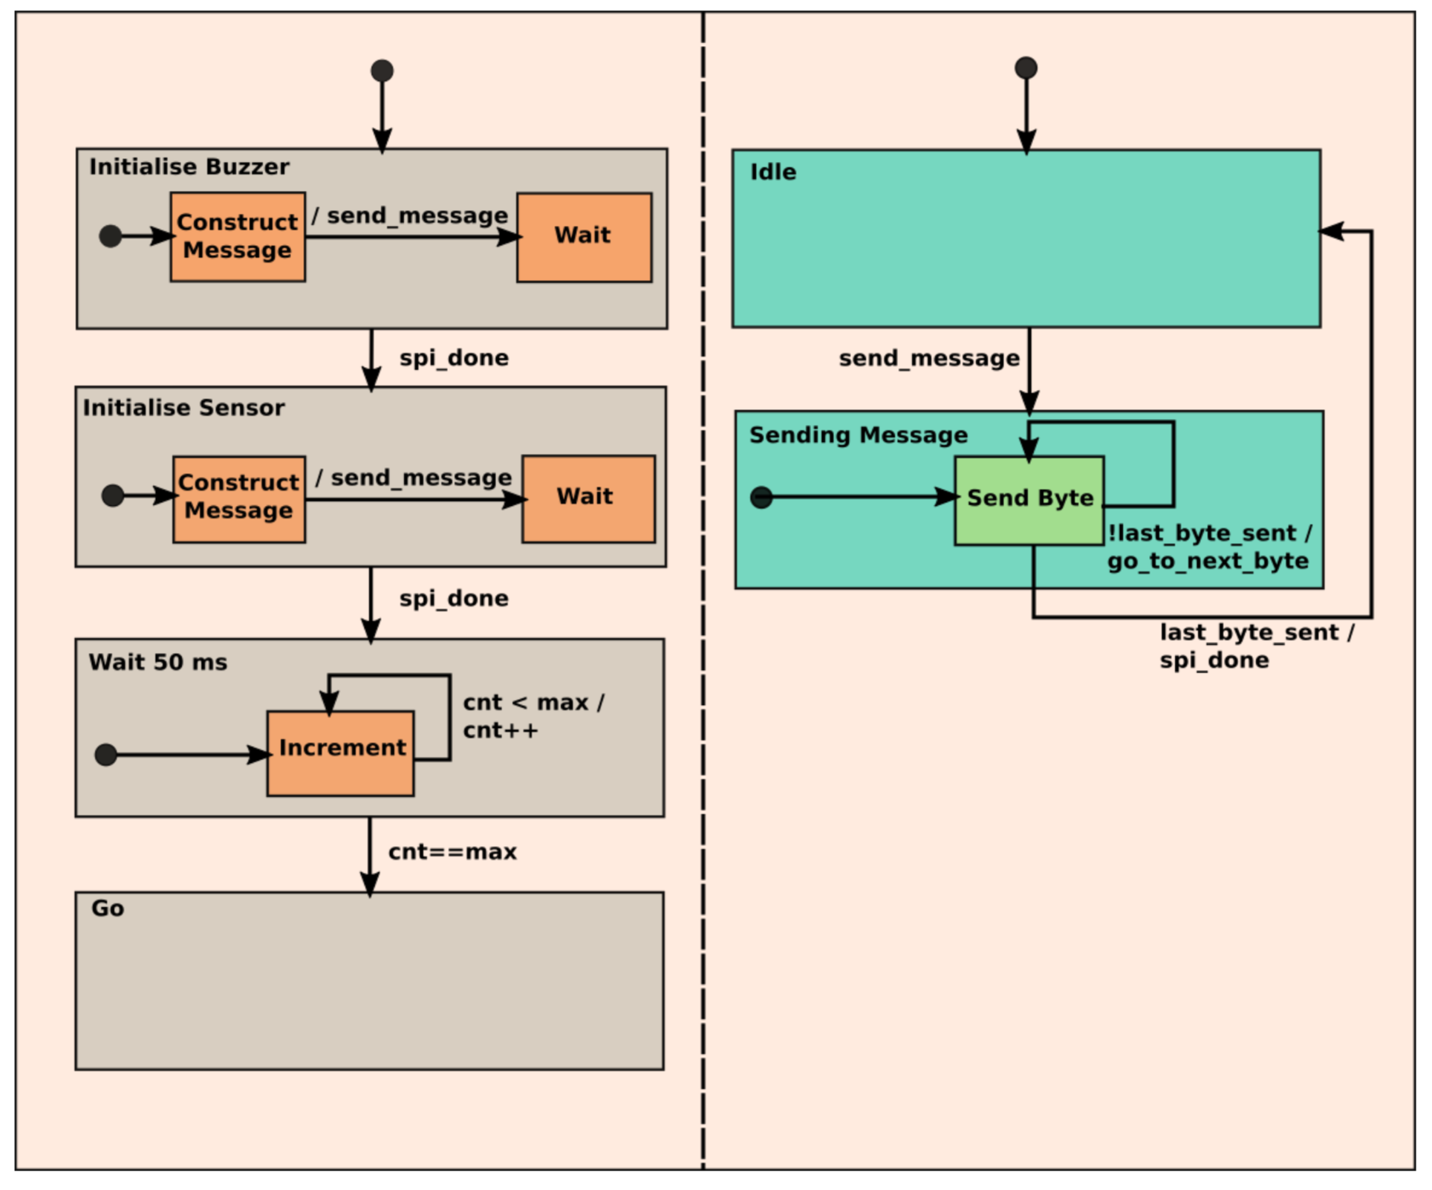
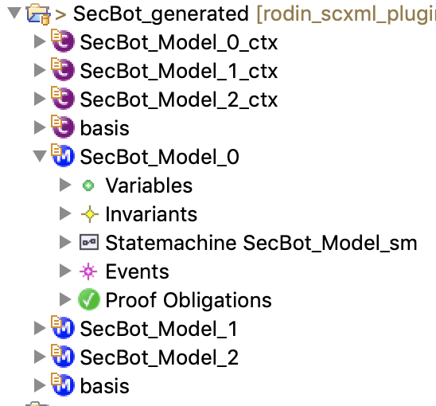
Translation - example
AUTOMATICALLY
GENERATED
SCXML Model = “SecBot”
Invariant: Idle = TRUE
(Annotated with refinement levels 0,1,2)
Automatically run iUML-B state-machine generator

Slide 21
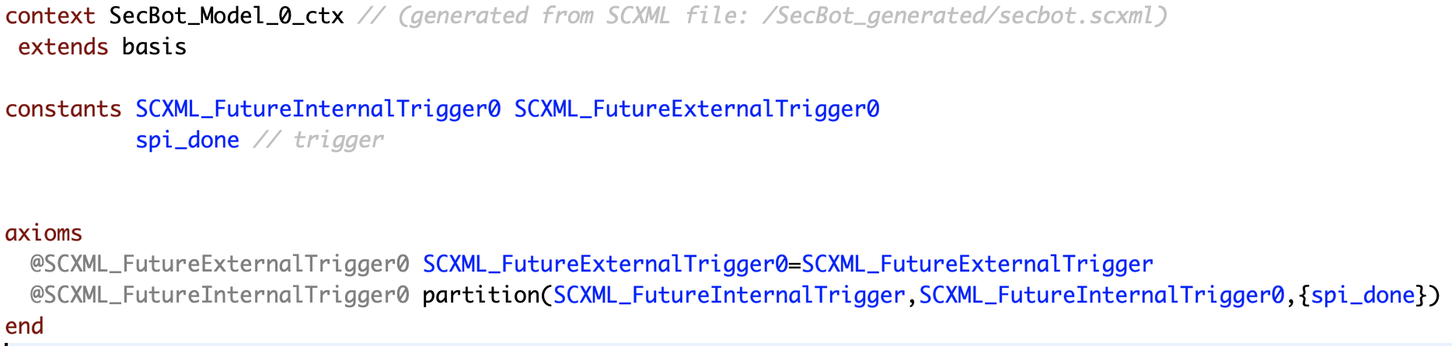
SecBot_Model_0: Introducing a trigger
AUTOMATICALLY
GENERATED

Slide 22
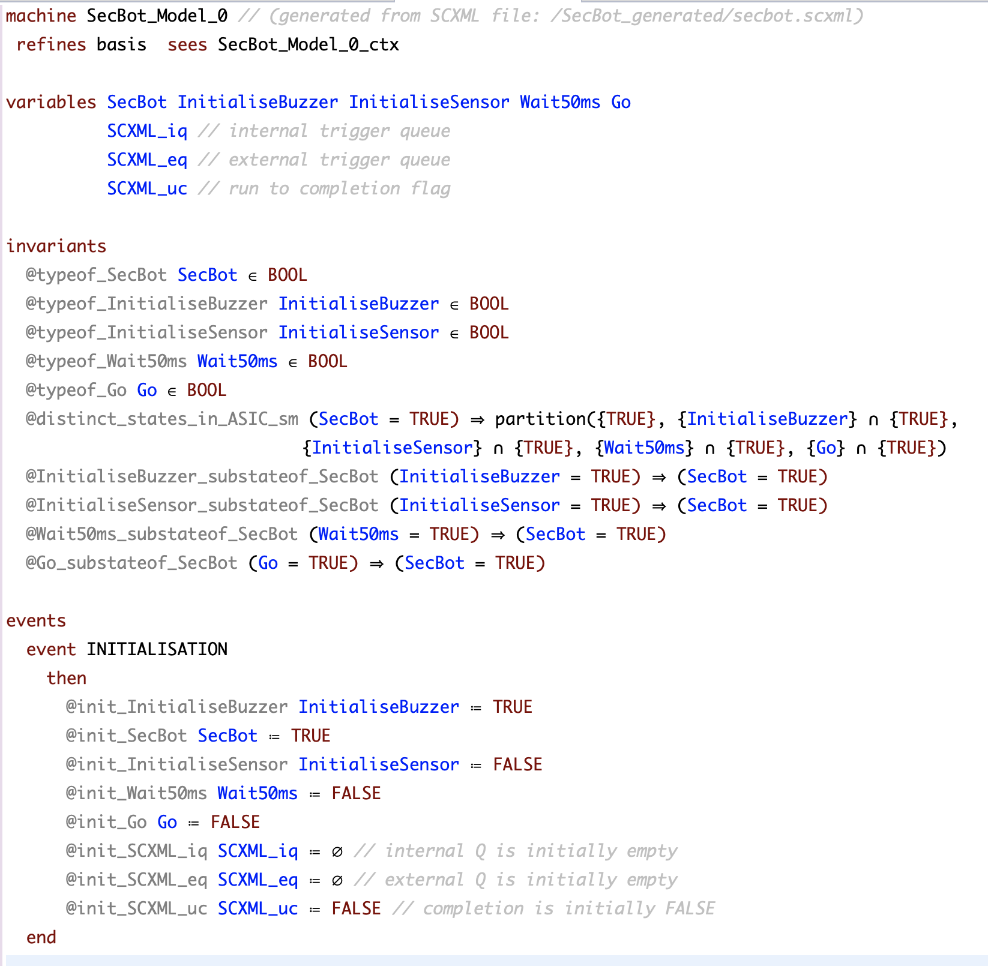
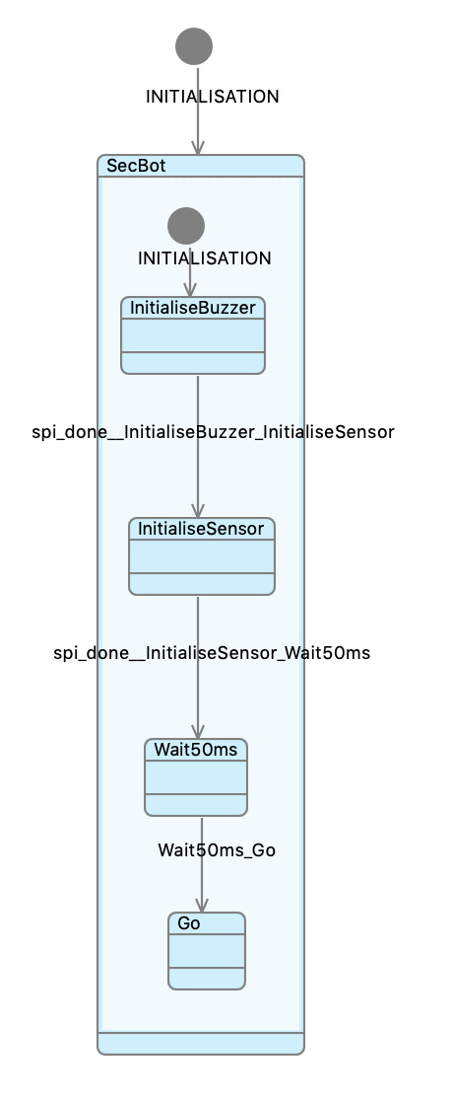
SecBot_Model_0
AUTOMATICALLY
GENERATED
AUTOMATICALLY
GENERATED

Slide 23
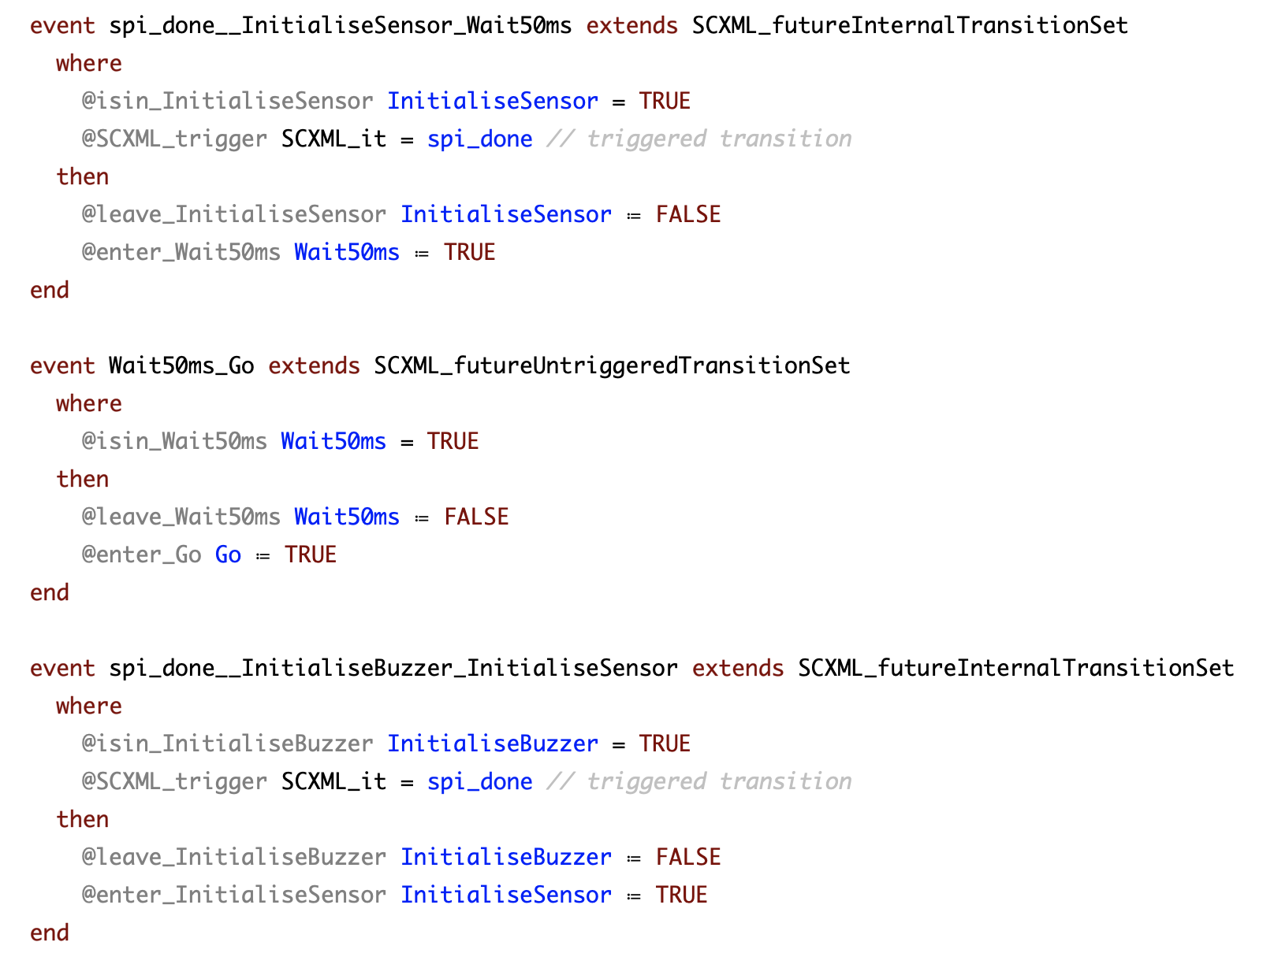
SecBot_Model_0
AUTOMATICALLY
GENERATED

Slide 24
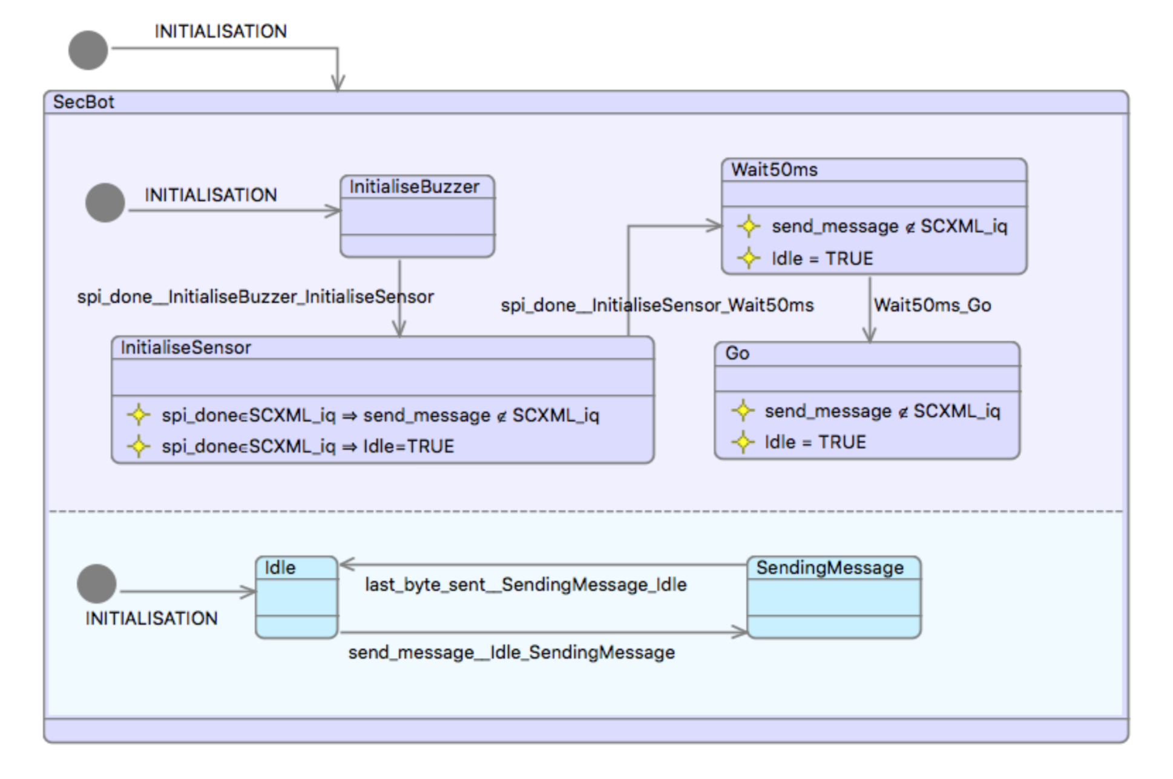
Example proof (SecBot_Model_2)
n.b. invariants are in SCXML

Slide 25
Summary
Industry driven:
R2C Statecharts + refinement + theorem proof
We use Event-B to leverage refinement and proof
…and UML-B gives us state-machine syntax
A proper abstraction of the completion –
should be able to skip transitions
unless you declare finalised (= no more guard strengthening)
Abstract Basis captures R2C semantics
Could be exchanged for a different semantics

Slide 26
Thank you
Questions?

